Slide 1
Paragraph Formatting
Microsoft Word 2013
Lesson 4

Slide 2
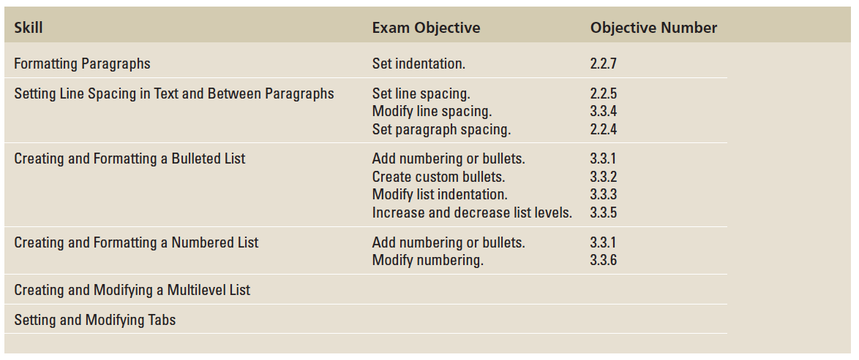
Objectives

Slide 3
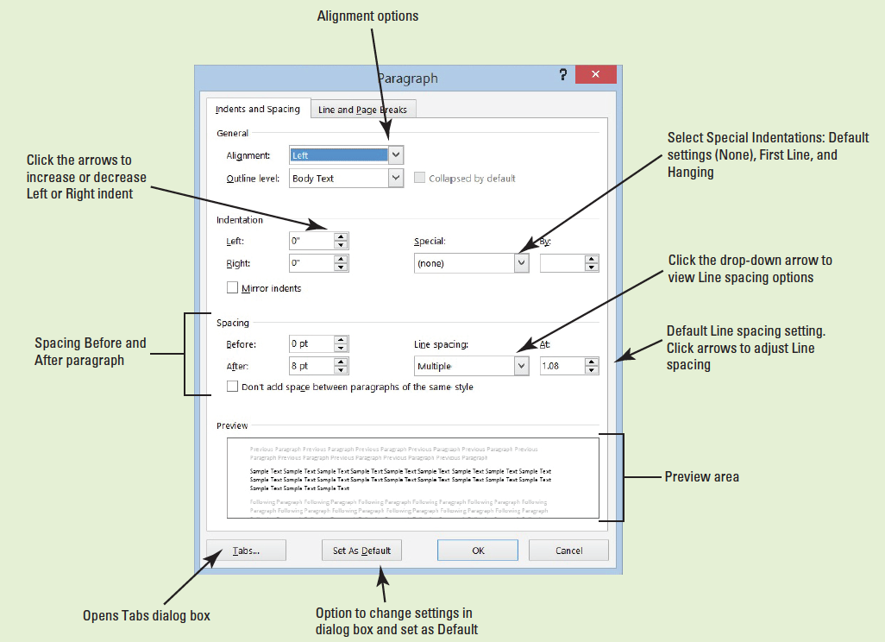
Software Orientation
The Paragraph dialog box contains Word’s commands for changing paragraph alignment, indentation, and spacing. The Indents and Spacing tab of the Paragraph dialog box is shown below.

Slide 4
Formatting Paragraphs
Paragraph formatting is an essential part of creating effective, professional-looking documents.
When a document is formatted properly and text is spaced and positioned, the reader can focus on the content.
Word’s paragraph formatting features let you determine paragraph alignment, indentation, and spacing between paragraphs. You can also remove paragraph formatting altogether.

Slide 5
Setting Indents
Indents can be used to set paragraphs off from other text in your documents.
The commands for indenting paragraphs are available in the Paragraph command group on the Home tab, as well as in the Paragraph command group of the Page Layout tab. Both command groups have dialog box launchers that give you access to additional commands.
An indent is a blank space inserted between text and the left or right margin.
A first-line indent inserts blank space between the left margin and the first line of the paragraph.
A hanging indent, begins the first full line of text in a paragraph at the left margin; all the remaining lines in the paragraph are then indented from the left margin.

Slide 6
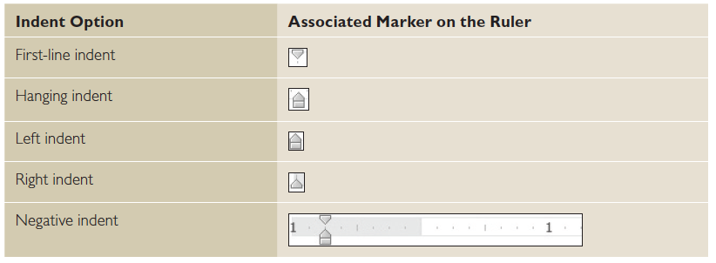
Setting Indents
A negative indent extends paragraph text into the left margin. You can indent paragraphs from the left margin, the right margin, or both, and you can set the sizes of indents using Word’s paragraph-formatting tools. You can also drag the markers on the ruler to set indents.
The table below shows the various indent markers as they appear on the ruler.

Slide 7
Step by Step: Set First-Line Indents
GET READY. Before you begin these steps, be sure to launch Microsoft Word.
Connect your flash drive to one of the USB ports on your computer.
Click the File tab, and then click Computer.
Click the Browse tab. Use the vertical scroll bar to scroll down and locate the data files for this lesson on your flash drive. Double-click the lesson folder to open it.
Locate and OPEN the file named Books Beyond.
Click the View tab. Then, in the Show group, click the check box that displays the Ruler.
Select the paragraphs under Acknowledgement.

Slide 8
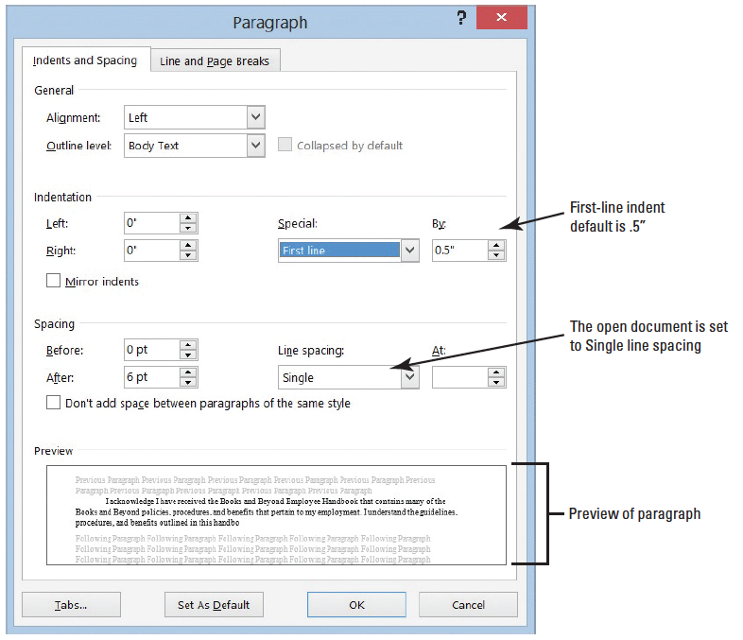
Step by Step: Set First-Line Indents
On the Home tab, in the Paragraph group, click the dialog box launcher located in the right corner of the group. Verify that the Indents and Spacing tab is the active tab.
In the Indentation section of this tab, change the Special selection by clicking the drop-down arrow and selecting First line. The By box lists 0.5 inches by default, as shown at right.

Slide 9
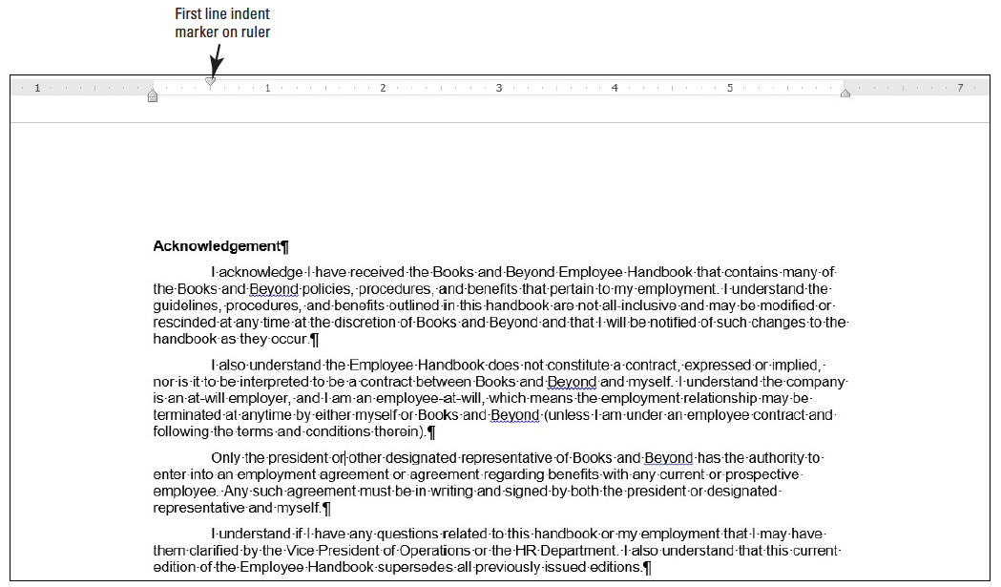
Step by Step: Set First-Line Indents
Click OK. The first line of each paragraph is indented .5 inches from the left margin.
Figure 4-3 displays the ruler and the paragraphs with the first-line indent you just set.
Notes:
Another Way: You can also click to place the insertion point anywhere within the paragraph to set the indent, and then drag the first-line indent marker on the ruler (see Figure 4-3) to the place where you want the text to be indented.

Slide 10

Step by Step: Set First-Line Indents
Select the four paragraphs under Introduction.
On the horizontal ruler, press and hold the left mouse button and drag the First-line indent marker to 0.5 inches.
Select all the paragraphs under the General Performance Expectation Guidelines.
On the Page Layout tab, in the Paragraph group, launch the Paragraph dialog box, and change the Special selection to First Line by clicking the drop-down arrow. Click OK to accept the default setting of 0.5 inches.
Select both paragraphs under the Equal Employment Opportunity and Diversity.
Right-click and select Paragraph—this is another way to open the Paragraph dialog box.
Notes:
Troubleshooting: Click the View tab and choose Ruler from the Show command group.

Slide 11
Step by Step: Set First-Line Indents
Change the Special selection to First Line. Click OK. Using a shortcut method, you can also access the Paragraph dialog box.
SAVE the document as B&B First Line Indent in the lesson folder on your flash drive.
PAUSE. LEAVE the document open to use in the next exercise.
Notes:
Another Way: To indent the ﬁrst line of a paragraph, click in front of the line and press Tab. To indent an entire paragraph, select the whole paragraph and press Tab.

Slide 12
Step by Step: Set Hanging Indents
USE the document that is open from the previous exercise.
Place the insertion point at the beginning of the first paragraph under the heading Acknowledgement, and then select the first two paragraphs.
On the Home tab, launch the Paragraph dialog box and change the Special selection from First Line to Hanging. Click OK. The first line of both paragraphs begin at the left of the margin whereas the remaining paragraphs are indented 0.5 inches from the left margin.

Slide 13
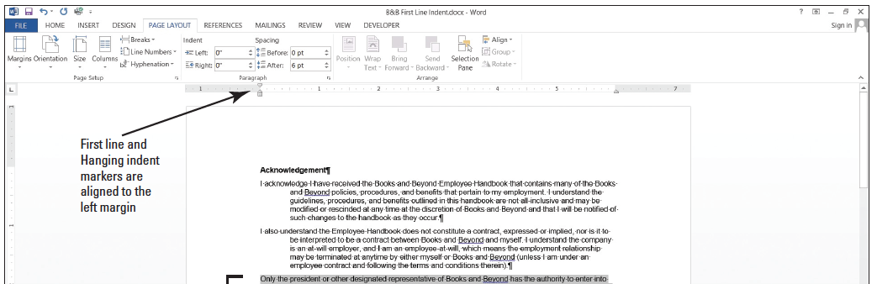
Step by Step: Set Hanging Indents
Under the same heading, select the last two paragraphs. On the horizontal ruler, press and hold the left mouse button and drag the first-line indent marker so that it aligns with the left margin. You need to reposition the first-line indent marker so that it doesn’t move when you begin dragging the hanging indent marker. Your markers on the ruler should match the figure below.

Slide 14
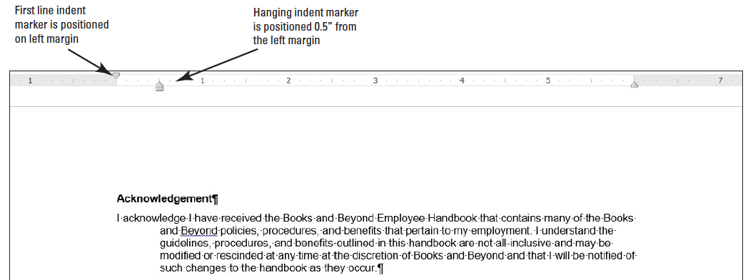
Step by Step: Set Hanging Indents
Press and hold the left mouse button and drag the hanging indent marker to 0.5 inches. You have now repositioned the marker using the ruler, and both paragraphs are indented. Your document should look similar to the one below.
SAVE the document as B&B Hanging Indent in the lesson folder on your flash drive.
PAUSE. LEAVE the document open to use in the next exercise.

Slide 15
Step by Step: Set Left and Right Indents
USE the document that is open from the previous exercise.
Select the paragraphs under Introduction.
You will move the first-line indent back to the default settings. Launch the Paragraph dialog box from the Home tab. Under the Special group, select (none). Click OK. Notice the paragraphs are left aligned.
Select the first two paragraphs under Introduction.

Slide 16

Step by Step: Set Left and Right Indents
Right-click and click Paragraph to open the dialog box. In the Indentation group, change the left and right indents to 1 inch by clicking the up arrow. Click OK.
Select the last two paragraphs under the same heading.
On the Page Layout tab, in the Paragraph group, click the up arrow next to Indent Left to indent the left side of the paragraph to 1 inch on the ruler.

Slide 17

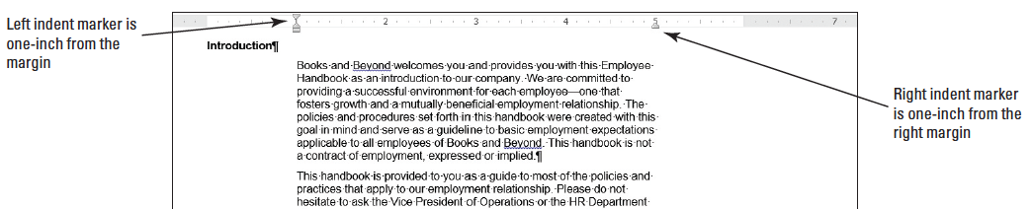
Step by Step: Set Left and Right Indents
Click the up arrow next to Indent Right to indent the right side of the paragraph to 1 inch on the ruler. Notice that paragraphs are one inch from the left and right margin (below).
SAVE the document as B&B Left&Right Indent in the lesson folder on your flash drive.
PAUSE. LEAVE the document open to use in the next exercise.

Slide 18
Step by Step: Set Negative Indents
USE the document that is open from the previous exercise.
Under the Equal Employment Opportunity and Diversity heading, select both paragraphs.
Launch the Paragraph dialog box from the Home tab. Under the Special group, select (none). Click OK.
Select the first paragraph under the heading.

Slide 19
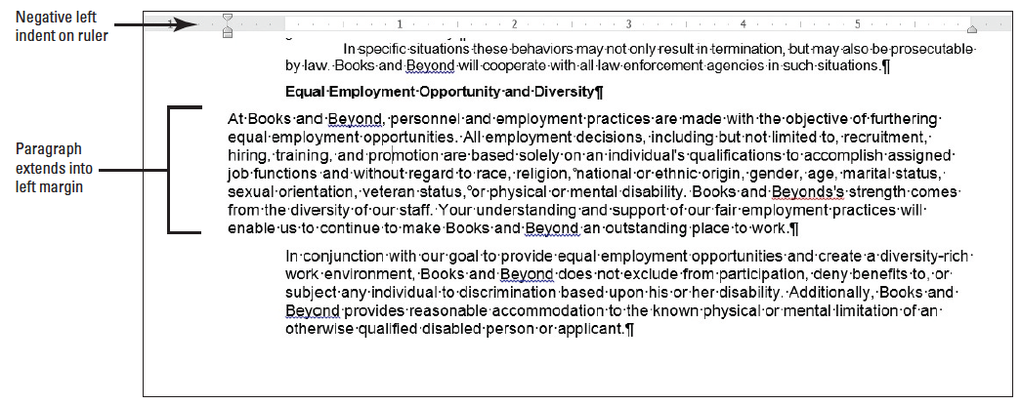
Step by Step: Set Negative Indents
Click the Page Layout tab, in the Paragraph group, click the down arrow next to Indent Left to indent the left side of the paragraph to -0.5 inch on the ruler as shown below.
Position your insertion point anywhere in the last paragraph, and then launch the Paragraph dialog box from the Page Layout tab.

Slide 20
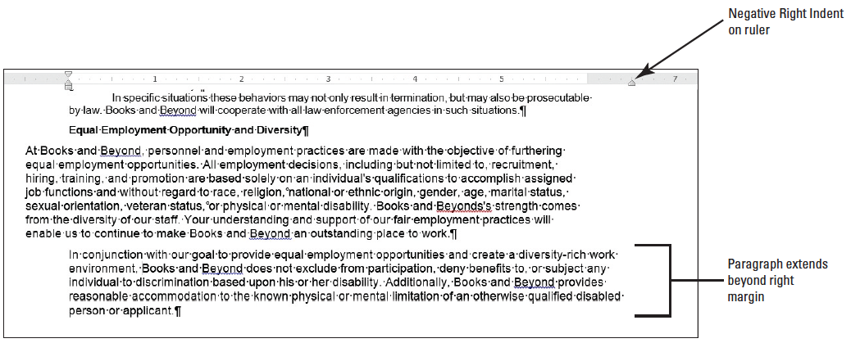
Step by Step: Set Negative Indents
Under the Indentation group, click the down arrow next to Right to indent the right side of the paragraph to -0.5 inch (below). When repositioning the indentations, you can select or place the insertion point anywhere in the paragraph.
SAVE the document as B&B Negative Indent in the lesson folder on your flash drive, and then CLOSE the file.
PAUSE. LEAVE Word open for the next exercise.
Notes:
Another Way: To access the Paragraph dialog box using the shortcut method, place the insertion point in the paragraph, and then right-click and select Paragraph from the menu that appears.
Take Note: Changing paragraph indents can be completed using the Ruler or launch the Paragraph dialog box found on the Home or Page Layout tabs.

Slide 21
Changing Alignment
Paragraph alignment refers to how text is positioned between a document’s margins. By default, text is left-aligned at the top of the page.
Horizontal alignment refers to how text is positioned between the left and right margins. There are four types of horizontal alignments: left align, center align, right align, or justify.
Horizontal alignment can be changed in the Paragraph group, which can be accessed on both the Home tab and the Page Layout tab.

Slide 22
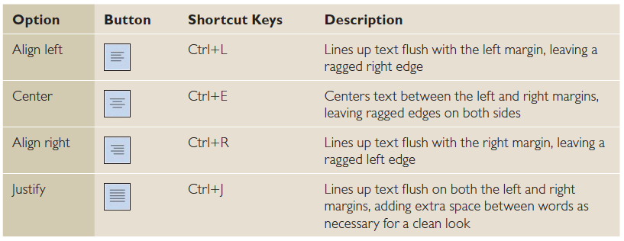
Changing Alignment
When the Paragraph dialog box is open and the Indents and Spacing tab is active, you can change alignment in the General section of the tab. Alternatively, you can use the shortcut keys shown in the table below.

Slide 23
Changing Alignment
Vertical alignment refers to how text is positioned between the top and bottom margins of the page.
Top-of-the-page vertical alignment is the default when launching Word.
Centered vertical alignment places the text evenly between the top and bottom margins.
Bottom vertical alignment places text next to the bottom margin of the document.

Slide 24
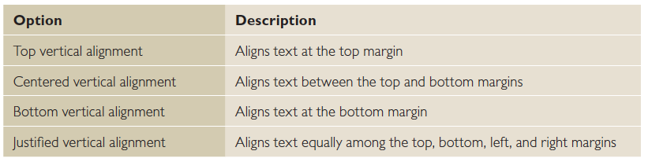
Changing Alignment
Justified vertical alignment aligns text evenly among the top, bottom, left, and right margins (see the table below).
There are two ways to set vertical alignment.
From the Page Layout tab, in the Page Setup group, launch the Page Setup dialog box. From the Layout tab, under the Page group, you will find the Vertical Alignment pull-down menu.
From the File tab, select Print then Page Setup. This launches the Page Set up dialog box also. From the Layout tab, under the Page group, you will find the Vertical Alignment pull-down menu.

Slide 25

Step by Step: Change Alignment to Justify
OPEN Books Beyond from the data files from this lesson.
Select all paragraphs under Acknowledgement.
On the Home tab, in the Paragraph group, click the Justify button. The paragraphs are justified between the left and right margins. Notice that the Justify button is highlighted.
Select all paragraphs under Introduction.
On the Home tab, in the Paragraph group, click the arrow in the lower-right corner of the group to launch the Paragraph dialog box. The Indents and Spacing tab should be selected.
In the Alignment list under General, click the drop-down arrow, and then click Justified. Click OK.

Slide 26
Step by Step: Change Alignment to Justify
Select the first two paragraphs under General Performance Expectation Guidelines. Avoid selecting the numbered list.
Press Ctrl+J to justify the paragraphs. Using the keyboard shortcut is a quick way to change the alignment in a paragraph.
Select the two paragraphs under Equal Employment Opportunity and Diversity and justify the paragraph using one of the methods.
SAVE the document as B&B Justify in the lesson folder on your flash drive.
PAUSE. LEAVE the document open to use in the next exercise.

Slide 27
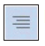
Step by Step: Change Alignment to Right
USE the document that is open from the previous exercise.
Place the insertion point in the first paragraph under Acknowledgement.
On the Home tab, in the Paragraph group, click the Align Right button. The right side of the paragraph is even whereas the left is uneven.
Select the second paragraph, right-click and select Paragraph.

Slide 28
Step by Step: Change Alignment to Right
In the Alignment list under General, click the drop-down arrow, and then click Right. Review the Preview area, the paragraph is right-aligned. Click OK.
Select the last two paragraphs, and press Ctrl+R to align the text on the right. The right side of the paragraph are even, whereas the left are uneven.
SAVE the document as B&B Right Align in the lesson folder on your flash drive.
PAUSE. LEAVE the document open to use in the next exercise.

Slide 29
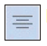
Step by Step: Change Alignment to Center
USE the document that is open from the previous exercise.
Place the insertion point in the Acknowledgement heading.
On the Home tab, in the Paragraph group, click the Center button. The heading is now centered between the left and right margin.
Use the multi-selection and select the headings, Introduction, General Performance Expectation Guidelines, and Equal Employment Opportunity and Diversity.
Press Ctrl+E to center the headings using the shortcut key.
SAVE the document as B&B Centered Headings in the lesson folder on your flash drive.
PAUSE. LEAVE the document open to use in the next exercise.

Slide 30

Step by Step: Change Alignment to Left
USE the document that is open from the previous exercise.
Select all paragraphs under Acknowledgement.
On the Home tab, in the Paragraph group, click the Left button. The paragraphs are now left-aligned, which is the default when you begin a new document.
Select all paragraphs under Introduction.
Right-click and select Paragraph to open the Paragraph dialog box.
In the Alignment list under General, click the drop-down arrow, and then click Left. Review the Preview area—the paragraphs are aligned left. Click OK.

Slide 31
Step by Step: Change Alignment to Left
Select the two paragraphs under General Performance Expectation Guidelines.
On the Page Layout tab, launch the Paragraph dialog box. In the Alignment list under General, click the drop-down arrow, and then click Left. Click OK.
Select the two paragraphs under Equal Employment Opportunity and Diversity.
Press Ctrl+L to align the paragraphs to the left using the shortcut key.
SAVE the document as B&B Left Align in the lesson folder on your flash drive.
PAUSE. LEAVE the document open to use in the next exercise.

Slide 32
Step by Step: Change Alignment to Vertical
USE the document that is open from the previous exercise.
Select the text beginning with the heading Introduction… to the end of the document and press Delete.
Press Ctrl+Home to position the insertion point at the beginning of the document.
On the Page Layout tab, in the Page Setup group, click the arrow in the lower-right corner of the group to open the Page Setup dialog box.
Select the Layout tab.
In the Vertical alignment list under Page, click the drop-down arrow and select Center.

Slide 33
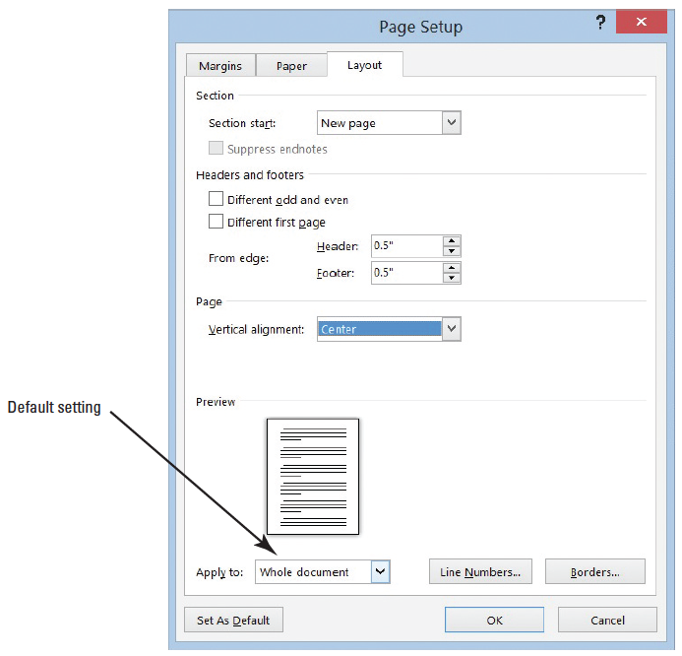
Step by Step: Change Alignment to Vertical
In the Apply to list under Preview, Whole document is selected, as the default shown at right.
Click OK. The text is centered between the top and bottom margins, as shown on the nest slide.
SAVE the document as B&B Vertical Alignment in the lesson folder on your flash drive.
PAUSE. LEAVE the document open to use in the next exercise.

Slide 34
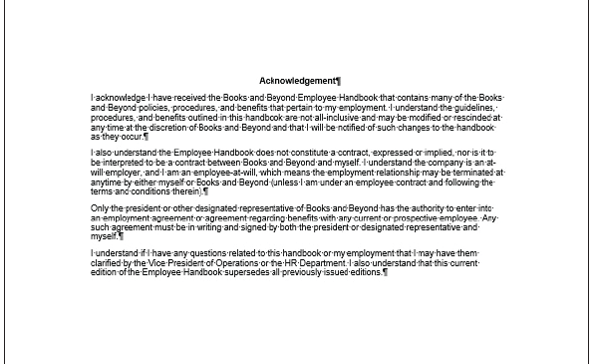
Step by Step: Change Alignment to Vertical

Slide 35
Shading a Paragraph
To apply shading to a paragraph, click the Shading button in the Paragraph group.
To choose another color, click the drop-down arrow next to the Shading button, and choose a color in the current theme or a standard color from the Shading menu (place your insertion point over a color to see a ScreenTip with the color’s precise name).
To remove shading, click No Color.
Click More Colors to open the Colors dialog box, where additional options are available. You can choose standard colors in the Standard tab, or you can create a custom color from the Custom tab.

Slide 36
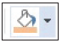
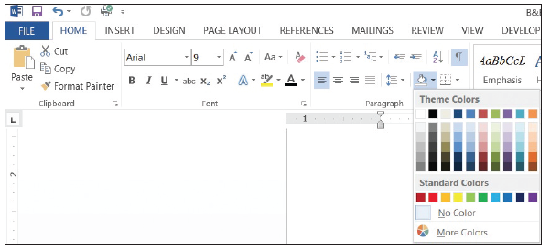
Step by Step: Shade a Paragraph
USE the document that is open from the previous exercise.
Select the first paragraph under the heading.
On the Home tab, in the Paragraph group, click the drop-down arrow next to the Shading button to display the menu shown below.

Slide 37
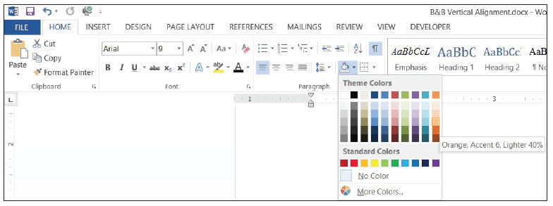
Step by Step: Shade a Paragraph
In the Theme Colors palette, locate and select the Orange, Accent 6, Lighter 40% as shown below.
SAVE the document as B&B Shaded Paragraph in the lesson folder on your flash drive.
PAUSE. LEAVE the document open to use in the next exercise.

Slide 38
Placing a Border around a Paragraph or Text
You can apply a border to a paragraph by clicking the Border button in the Paragraph group on the Home tab.
To change the border style, click the drop-down arrow next to the Border button.
For additional options, click the Borders and Shading option on the Border menu to open the Borders tab of the Borders and Shading dialog box.
You can choose a number of border colors and styles in this dialog box, or you can remove a border completely. This dialog box also contains tabs for page border options and shading.

Slide 39
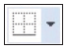
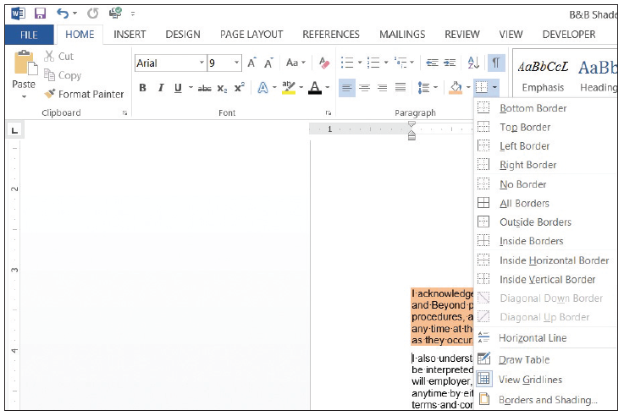
Step by Step: Place a Border around a Paragraph
USE the document that is open from the previous exercise.
Place the insertion point in the second paragraph beginning with “I also understand…”
On the Home tab, in the Paragraph group, click the drop-down arrow next to the Border button to display the menu shown below.

Slide 40
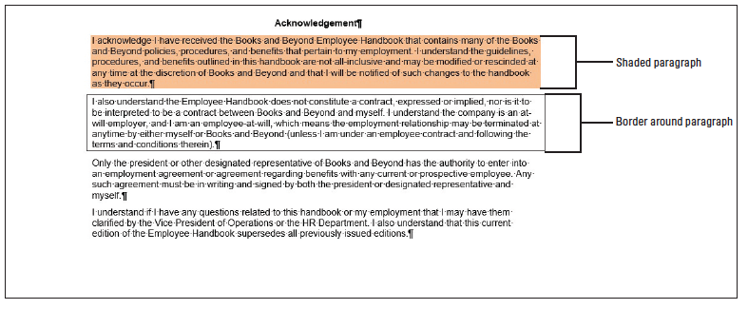
Step by Step: Place a Border around a Paragraph
Select Outside Borders on the menu. Your document should look similar to the figure below.
Place the insertion point in the third paragraph.

Slide 41
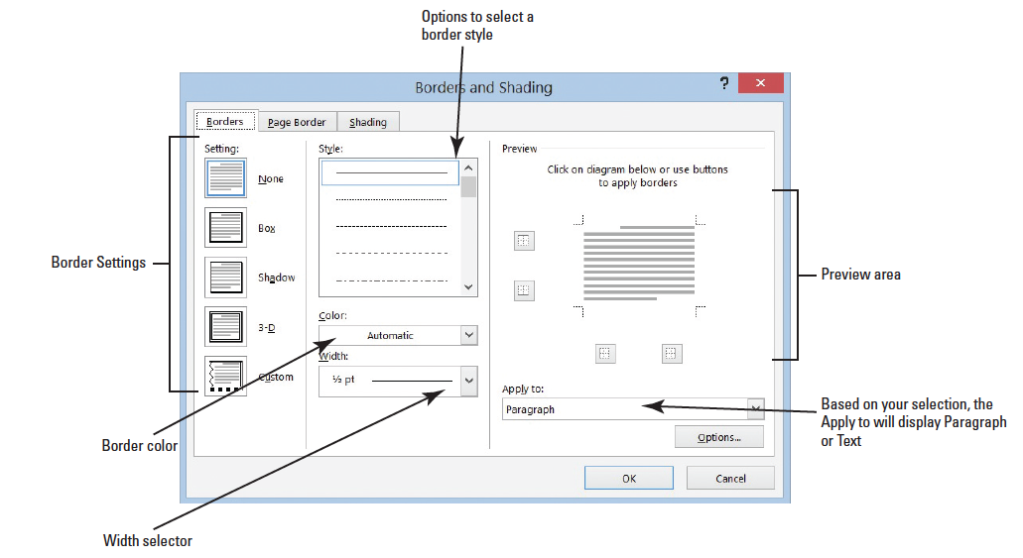
Step by Step: Place a Border around a Paragraph
On the Design tab, in the Page Background group, click Page Borders to open the Borders and Shading dialog box, and then click the Borders tab to make it active (see below). The Design tab on the Ribbon is a new tab for Word 2013 and contains many additional features to format a document.

Slide 42
Step by Step: Place a Border around a Paragraph
Select Shadow under the Settings.
Select the ninth option under Style. Select Dark Blue, Text 2 for color, and change the width to 2 ¼ pt.
Review the Preview area before you click OK. Note that the border is applied to the paragraph.
SAVE the document as B&B with Borders in the lesson folder on your flash drive.
PAUSE. LEAVE the document open to use in the next exercise.
Notes:
Take Note: Borders can also be added to pages, sections, tables, cells, graphic objects, and pictures.
Another Way: The Borders and Shading dialog box can be accessed by clicking the drop-down arrow next to the Border [Prod: insert MA0413.jpg here] button, and then selecting Borders and Shading.

Slide 43
Step by Step: Place a Border around Text
USE the document that is open from the previous exercise.
On the Home tab, enable the Show/Hide to display the nonprinting character. Select the title without selecting the Show/Hide ( ¶ ) symbol.
On the Home tab, in the Paragraph group, click the drop-down arrow next to the Border button to display the menu and select Borders and Shading to open the dialog box.

Slide 44
Step by Step: Place a Border around Text
Click the Borders tab to make it active. Notice the title appears in the Preview area and the Apply to section Text button is displayed. Not selecting the nonprinting character (¶) allows you to place a border around text only.
Select Box under Setting and change the width to 1½ pt. Click OK. Notice that the border wraps around the text.
SAVE the document with the same filename in the lesson folder on your flash drive.
PAUSE. LEAVE the document open to use in the next exercise.

Slide 45
Step by Step: Removing Borders around Text or a Paragraph
USE the document that is open from the previous exercise.
Place the insertion point in the second paragraph under the heading.
On the Home tab, in the Paragraph group, click the drop-down arrow next to the Border button to display the menu and select Borders and Shading. The Borders and Shading dialog box opens.
Select the Borders tab, and then select None under Setting. Click OK.
Remove the border on the third paragraph and title by repeating steps 2 and 3.
For the title select only the text before completing steps 2 and 3.
SAVE the document as B&B with No Borders in the lesson folder on your flash drive.
PAUSE. LEAVE the document open to use in the next exercise.
Notes:
Another Way: Select text or paragraph, click the drop-down arrow by Borders in the Paragraph group, and then click No Border.

Slide 46
Step by Step: Clear Paragraph Formats
USE the document that is open from the previous exercise.
Select the whole document.
On the Home tab, in the Font group, click the Clear Formatting button.
SAVE the document as B&B No Formatting in the lesson folder on your flash drive, and then CLOSE the file.
PAUSE. LEAVE Word open for the next exercise.

Slide 47
Setting Line Spacing in Text and Between Paragraphs
You can determine how much space separates lines of text and set the spacing between paragraphs. By default, Word sets line spacing (the space between each line of text) to 1.15.
Line spacing is paragraph based and can be customized by specifying a point size.
Paragraph spacing, which affects the space above and below paragraphs, is set to 8 points after each paragraph by default. The higher the point size is, the greater the space between paragraphs.

Slide 48
Setting Line Spacing
Line spacing is the amount of space between the lines of text in a paragraph.
Line spacing options are available in the Home and Page Layout tabs within the Paragraph group by using the Line and Spacing button.
The line spacing options can also be accessed through the Indents and Spacing tab of the Paragraph dialog box.

Slide 49
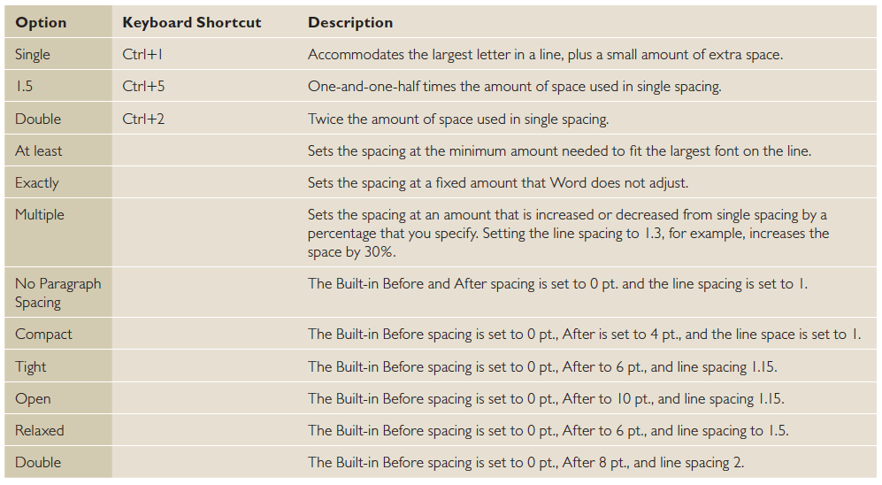
Setting Line Spacing
New in Word 2013 is the Design tab, which includes Paragraph Spacing. The table below provides additional information regarding line spacing options and descriptions.

Slide 50
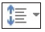
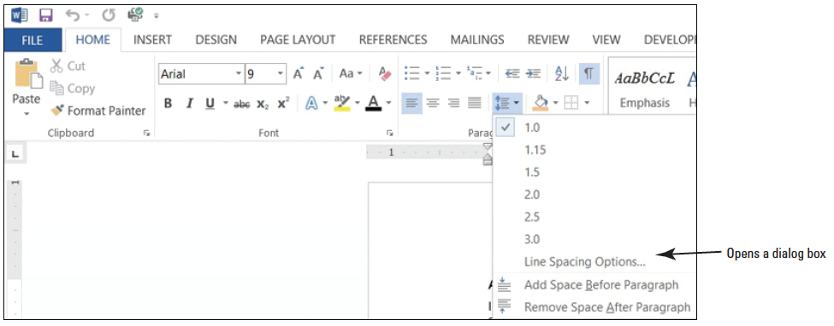
Step by Step: Set Line Spacing in a Paragraph
OPEN the Books Beyond document from the lesson folder.
Place the insertion point in the first paragraph under the Acknowledgement heading.
On the Home tab, in the Paragraph group, click the Line and Paragraph Spacing button to display the Line Spacing menu and options to add and remove spacing before and after paragraphs (see below).

Slide 51
Step by Step: Set Line Spacing in a Paragraph
Select 2.0 to double-space the text.
Place the insertion point in the second paragraph.
In the Paragraph group, launch the dialog box.
In the Spacing group, change the Line spacing by clicking the drop-down arrow and selecting Double. Click OK. The paragraph is now double-spaced.
Place the insertion point in the third paragraph.
Press Ctrl+2 to double-space the paragraph.

Slide 52
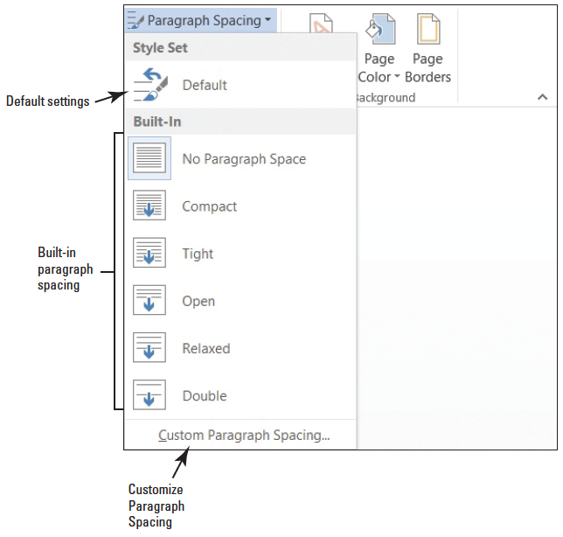
Step by Step: Set Line Spacing in a Paragraph
Click the Design tab and in the Document Formatting group, click the Paragraph Spacing button to display the menu as shown at right.
Select Double. Notice that the remaining document is double-spaced. This new feature in Word 2013 changes spacing for the entire document to include new paragraphs.
SAVE the document as B&B Double Spacing in the lesson folder on your flash drive.
PAUSE. LEAVE the document open to use in the next exercise.
Notes:
Take Note: When using the Document Formatting group to apply paragraph spacing, the document does not need to be selected when using one of the built-in formatting commands.

Slide 53
Step by Step: Modify Line Spacing in a Paragraph
USE the document that is open from the previous exercise.
Select the paragraphs under Acknowledgement.
Return to the Line and Paragraph Spacing drop-down menu in the Paragraph group on the Home tab. To set more precise spacing measurements, click Line Spacing Options to display the Indents and Spacing tab of the Paragraph dialog box.

Slide 54
Step by Step: Modify Line Spacing in a Paragraph
In the Line Spacing section, click the drop-down arrow and select Exactly in the Line Spacing list. In the At list, click the up arrow until it reads 22 pt. The line spacing is increased.
Click OK.
SAVE the document as B&B Exact Spacing in the lesson folder on your flash drive, and then CLOSE the file.
PAUSE. LEAVE the document open to use in the next exercise.

Slide 55
Setting Paragraph Spacing
Paragraphs are usually separated by a blank line in Word documents. When you press the Enter key at the end of a paragraph, Word adds the designated space above or below the paragraph.
By default, the spacing after a paragraph is set to 8 points and the spacing before paragraphs is set to zero, but you can change these settings for a single paragraph or for an entire document.
To increase or decrease paragraph spacing, click the Before and After up or down arrows in the Indents and Spacing tab of the Paragraph dialog box.
The Paragraph spacing can also be changed in the Paragraph group on the Home tab by clicking the Line Spacing button to Add Space Before or After Paragraph or Remove Space Before or After Paragraph.

Slide 56
Step by Step: Set Spacing around a Paragraph
OPEN the Books Beyond document from the lesson folder.
Select the entire document.
On the Home tab, in the Paragraph group, click the arrow in the lower-right corner of the group to display the Paragraph dialog box. The Indents and Spacing tab is the active tab.
In the Spacing section, click the up arrow next to Before until it reads 24 pt.
Click the up arrow next to After until it reads 24 pt. Review the preview area and notice the increase of spacing in the document.
Click OK. Notice the spacing between the paragraphs.

Slide 57
Step by Step: Set Spacing around a Paragraph
With the entire document still selected, click the drop-down arrow next to the Line and Paragraph Spacing button in the Paragraph group to display the Line Spacing menu.
Click Remove Space Before Paragraph.
Repeat step 6, and then click Remove Space After Paragraph. The spacing before and after have been removed from the document.
Place the insertion point in the heading, Acknowledgement.

Slide 58
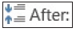
Step by Step: Set Spacing around a Paragraph
Click the Page Layout tab, and then in the Paragraph group, click the up arrow and increase the Spacing After to 12 pt.
Use the Format Painter and repeat step 10 for each heading, Introduction, General Performance Expectation Guidelines, and Equal Employment Opportunity and Diversity.
Use the multi-selection and select the paragraphs under each heading and change the Spacing After to 6 pt.
SAVE the document as B&B Spacing Before&After in the lesson folder on your flash drive, and then CLOSE the file.
PAUSE. LEAVE Word open for the next exercise.

Slide 59
Creating and Formatting a Bulleted List
Bulleted lists are an effective way to format lists of items that don’t have to appear in any specific order. (Use numbered lists for items in a set order.)
Items in a bulleted list are marked by small icons—dots, diamonds, and so on.
You can create bulleted lists from scratch, change existing lines of text into a bulleted list, choose from a number of bullet styles, create levels within a bulleted list, and insert a symbol or picture as a bullet.

Slide 60
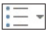
Step by Step: Create a Bulleted List
OPEN Alarm from the data files for this lesson.
Select the two paragraphs below the phrase Please keep in mind:.
On the Home tab, in the Paragraph group, click the button. Notice that solid circles appear before the selected paragraph.
Place the insertion point at the end of the second bulleted sentence.

Slide 61
Step by Step: Create a Bulleted List
Press Enter. Word automatically continues the bulleted list by supplying the next bulleted line.
Beside the new bullet, type If you do not know your four-digit code and password, please get it from the HR department.
SAVE the document as B&B Alarm in the lesson folder on your flash drive.
PAUSE. LEAVE the document open to use in the next exercise.

Slide 62
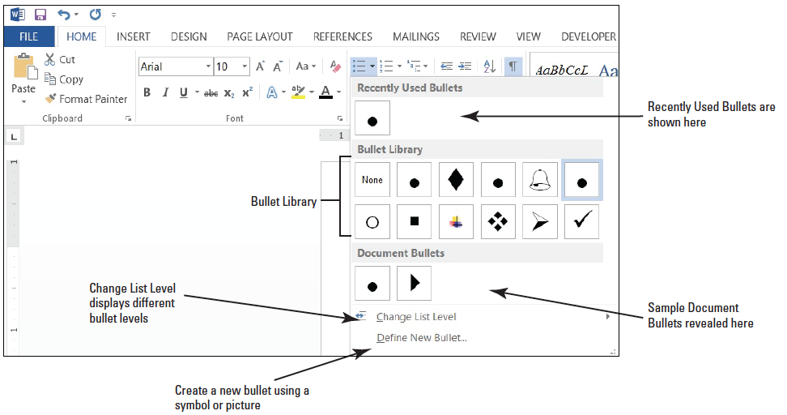
Step by Step: Change the Bulleted List
USE the document that is open from the previous exercise.
Select the entire bulleted list.
To change the format of the bulleted list, click the drop-down arrow next to the Bullets button to display the menu shown below. The bulleted items might not match your screen.
Notes:
Take Note: To change a bulleted list to a numbered list (or vice versa), select the list and then click either the Bullets button or the Numbering button. To remove one of the bullets from the Library, open the Bullet drop-down menu; then in the Bullet Library, select the bullet and right-click to remove it.

Slide 63
Step by Step: Change the Bulleted List
Click the hollow circle in the Bullet Library.
SAVE the document as B&B Alarm with Hollow Bullets in the lesson folder on your flash drive.
PAUSE. LEAVE the document open to use in the next exercise.

Slide 64
Step by Step: Change the Bullet Levels List
Adding an unordered list such as bullets appears with no rank over the others. Changing the bullet level list can change the appearance of the bullet and indentation.
USE the document that is open from the previous exercise.
Place the insertion point in the second bulleted item.

Slide 65
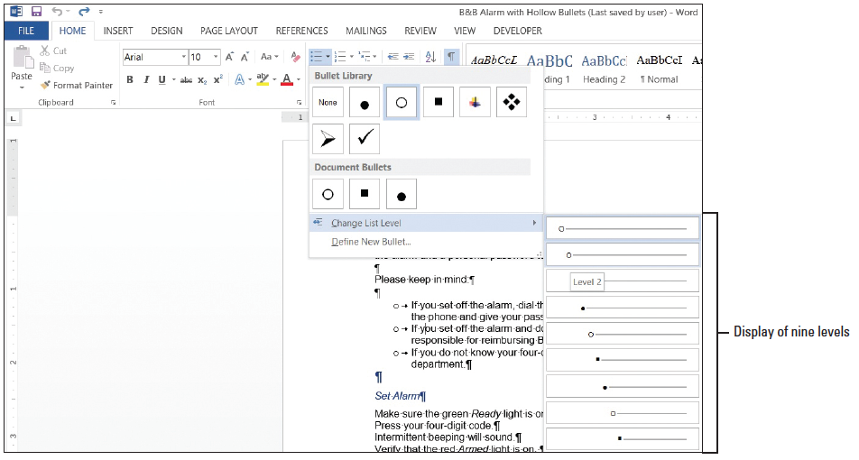
Step by Step: Change the Bullet Levels List
Click the drop-down arrow next to the Bullets button, point to Change List Level, and note the levels that appear (see below). When you point to the Level List, a ScreenTip appears displaying the level.

Slide 66
Step by Step: Change the Bullet Levels List
Click to select Level 2. The bullet item is demoted from Level 1 to Level 2. When levels are increased or decreased, the indentation is changed—see the markers on the rulers.
Place the insertion point in the third bulleted item.
Click the drop-down arrow next to the Bullets button, and then point to Change List Level to produce a menu of list-level options.

Slide 67
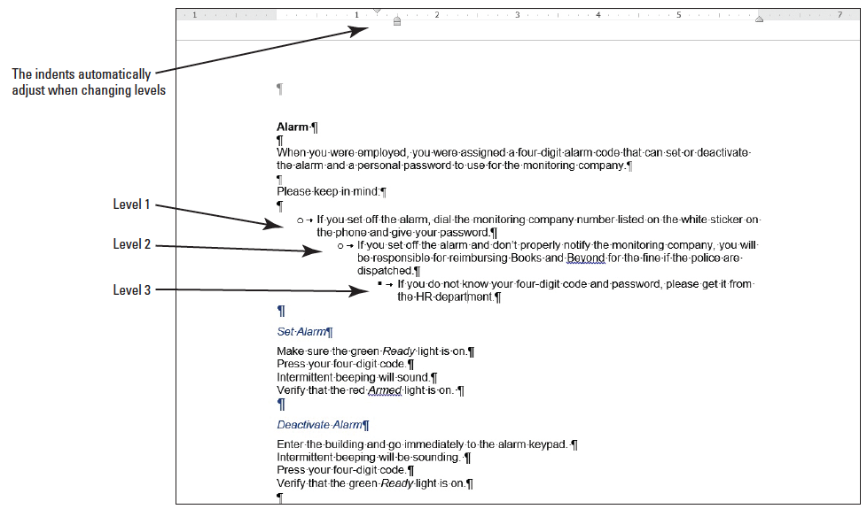
Click to select Level 3. Your document should look similar to the one shown below.
SAVE the document as B&B Alarm with Bullet Levels in the lesson folder on your flash drive.

Slide 68
Step by Step: Change the Bullet Levels List
Select the second and third bulleted items and click the drop-down arrow next to the Bullets button. Point to Change List Level and promote the selected bullets to Level 1. The two selected items now match the first bulleted item.
Click Undo to return the bulleted items to second and third level.
SAVE the document with the same filename in the lesson folder on your flash drive.
PAUSE. LEAVE the document open to use in the next exercise.

Slide 69
Step by Step: Insert Special Character Symbols
The Define New Bullet dialog box provides options to change the alignment and add bullet characters, such as a symbol or a picture.
When you click on either option, a new dialog box opens.
USE the document that is open from the previous exercise.
Select the second and third bulleted items and Promote to the first level, and then select all three bulleted items.
Click the drop-down arrow next to the Bullets.

Slide 70
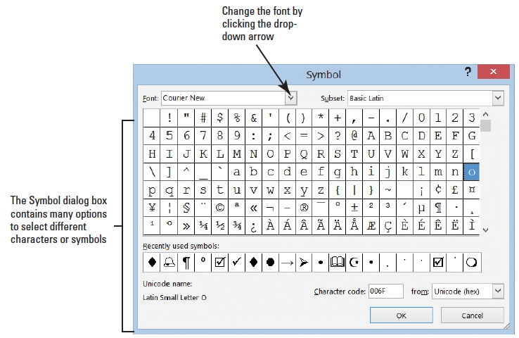
Step by Step: Insert Special Character Symbols
Click the Symbol button in the Define New Bullet dialog box. The Symbol dialog box opens, as shown at right.
Change the Font by clicking the drop- down arrow. Scroll down and select Wingdings.

Slide 71
Step by Step: Insert Special Character Symbols
Select the bell in the first row, sixth column. Click OK to close the Symbols dialog box.
Click OK to close the Define New Bullet dialog box.
SAVE the document as B&B Alarm Update in the lesson folder on your flash drive.
PAUSE. LEAVE the document open to use in the next exercise.

Slide 72
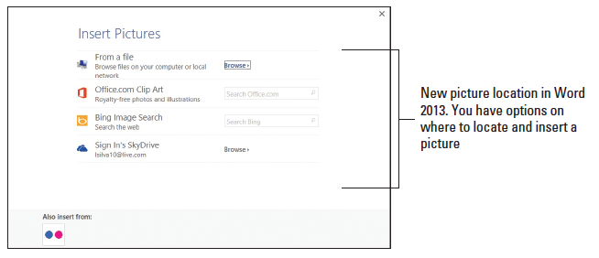
Step by Step: Insert a Picture Bullet
USE the document that is open from the previous exercise.
The three bulleted items are still selected. Click the drop-down arrow next to the Bullets button, and click Define New Bullet.
Click the Picture button in the Define New Bullet dialog box. The Insert Pictures location box opens, as shown below. Microsoft has provided a new insert picture location screen where you have can locate a picture from the Office.com location, Bing, SkyDrive, or in your computer or network.

Slide 73
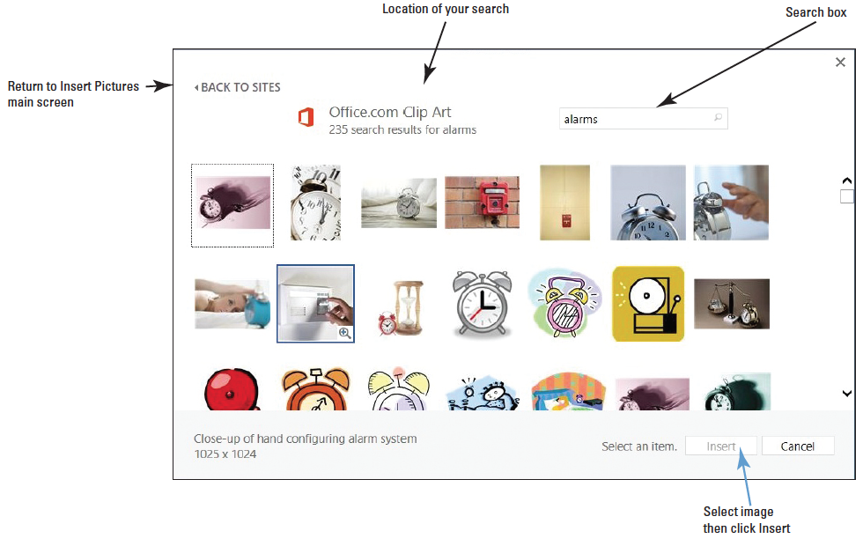
Step by Step: Insert a Picture Bullet
Type alarms in the Office.com Clip Art search box, and then click the magnifier to begin search.
Select the Close-up Hand configuring alarm system image as shownbelow. The image is surrounded by a border.

Slide 74
Step by Step: Insert a Picture Bullet
Click Insert to begin downloading the image to your document.
Click OK to close the Define New Bullet dialog box.
After the image is downloaded, it displays on your document in a small font size. Select the first image—notice the other two images are also selected. Increase the font size to 28 pt.
SAVE the document as B&B Alarm Update1 in the lesson folder on your flash drive.
PAUSE. LEAVE the document open to use in the next exercise.

Slide 75
Step by Step: Change the Alignment in Bullets
USE the document that is open from the previous exercise.
In the bulleted list, notice the distance from the text and image. Adding a custom bullet allows you to change the alignment.
Select the three bullets items.
Click the drop-down arrow next to the Bullets button, and then click Define New Bullet.
Under the Alignment group, click the drop-down arrow and select Right. Notice the space from the text and image in the Preview area.
Click OK.
SAVE the document with the same filename in the lesson folder on your flash drive.
PAUSE. LEAVE the document open to use in the next exercise.

Slide 76
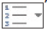
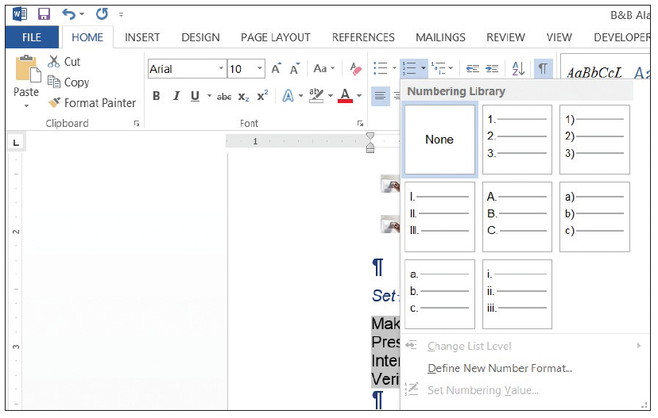
Step by Step: Create a Numbered List
USE the document that is open from the previous exercise.
Select the four paragraphs under the Set Alarm heading.
On the Home tab, in the Paragraph group, click the drop-down arrow next to the Numbering button to display the Numbering Library shown below.
Select the option, 1., 2., 3. The paragraphs are now listed as an ordered list.

Slide 77
Step by Step: Create a Numbered List
Place the insertion point at the end of item number four and press Enter. Notice that Word automatically numbers the next line sequentially.
In the new numbered line, type Leave the premises immediately.
Select the four paragraphs under the Deactivate Alarm heading.
On the Home tab, in the Paragraph group, click the drop-down arrow next to the Numbering button.
Select the option, a., b., c., The four paragraphs are numbered aligned left.
SAVE the document as B&B Numbered Alarm List in the lesson folder on your flash drive.
PAUSE. LEAVE the document open to use in the next exercise.

Slide 78
Step by Step: Modify a Numbered List
USE the document that is open from the previous exercise.
Select the numbered list under the Set Alarm heading.
To change the format of the numbered list, click the drop-down arrow next to the Numbering button, and then click Define New Number Format. The Define New Number Format dialog box appears.

Slide 79
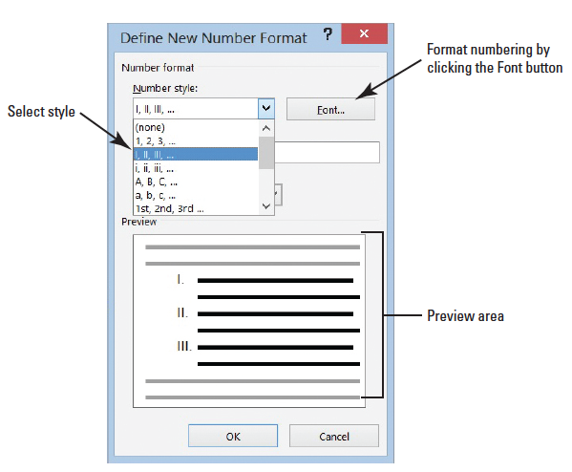
Step by Step: Modify a Numbered List
Click the drop-down arrow under the Number style section and select uppercase roman numerals (see right). The format for the selected text changed to uppercase roman numerals. The default alignment is left and can also be changed to center or right.

Slide 80
Step by Step: Modify a Numbered List
Click the Font button and select Arial Black, size 12 pt. Review the preview area to see how the numbering will appear. Click OK to close the Font dialog box.
Click OK to close the Define New Number Format dialog box.
Select the numbered list under the Deactivate Alarm heading.
Notes:
Take Note: To change the formatting of list numbers, click any number to select the entire list. If you select the text as well, the formatting of both the text and the numbering change.

Slide 81
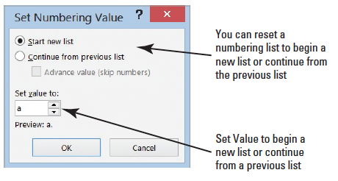
Step by Step: Modify a Numbered List
In this next step you renumber an existing list using the lowercase letters. Click the drop-down arrow next to the Numbering button, and then click Set Numbering Value. The Set Numbering Value dialog box appears as shown below.

Slide 82
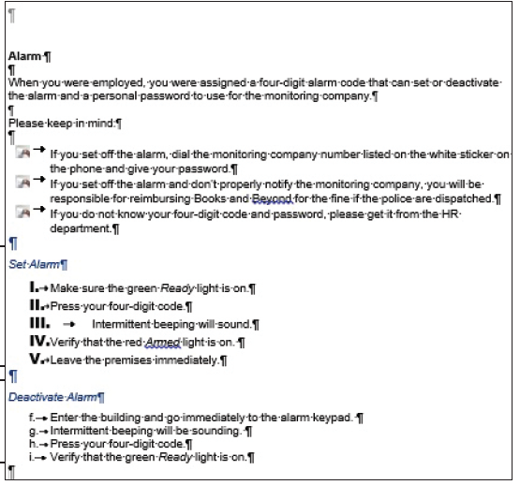
Step by Step: Modify a Numbered List
The radio button is already selected at Start new list; then in the Set value section, click the up-arrow to f. Your document should match the one at right.
SAVE the document as B&B Numbered Alarm List 1 in the lesson folder on your flash drive, and then CLOSE the file.
PAUSE. LEAVE the document open to use in the next exercise.

Slide 83
Step by Step: Change the Alignment to Numbering List
USE the document that is open from the previous exercise.
Select the numbered list under the Set Alarm heading.
To change the alignment format of the numbered list, click the drop-down arrow next to the Numbering button, and then click Define New Number Format. The Define New Number Format dialog box appears.
In the Alignment group, click the drop-down arrow and select Right to change the alignment of the numbering list.

Slide 84
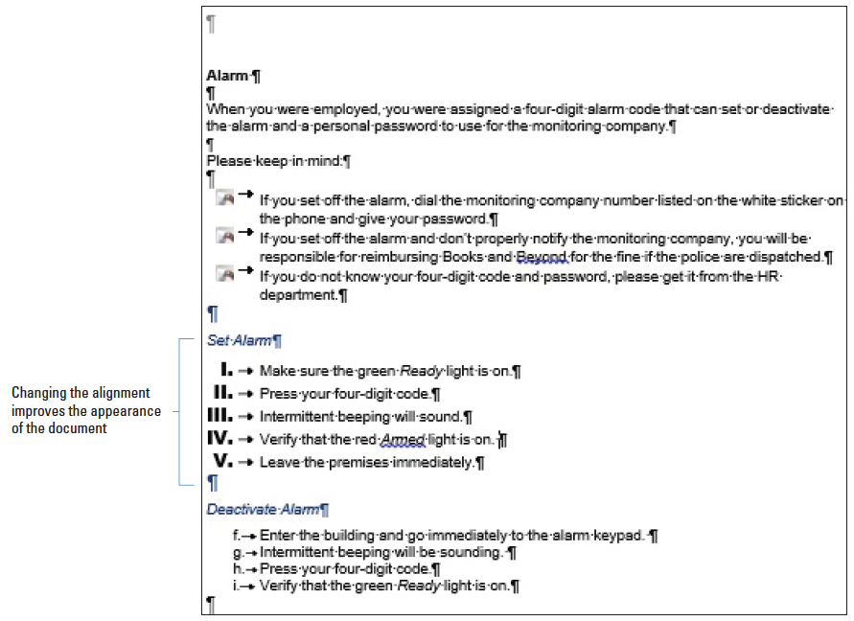
Step by Step: Change the Alignment to Numbering List
Click OK. Notice how nicely the list is aligned (see below).
SAVE the document as B&B Numbered Alarm List Final in the lesson folder on your flash drive, and then CLOSE the file.
PAUSE. LEAVE Word open to use in the next exercise.

Slide 85
Creating and Modifying a MultiLevel List
Word provides a multilevel feature that is used for outlines and other documents that require many levels—these levels can be a combination of letters and numbers.
Multilevel lists are typically used in documents where subsets of information are needed within the list, such as preparing an agenda, outline, or exam questions.
You can use the multilevel list for outlining your research paper.

Slide 86
Step by Step: Create a Multilevel Outline List
OPEN Outline from the data files for this lesson.
Position the insertion point on the blank line after the Discussion Outline heading.
On the Home tab, in the Paragraph group, click the Multilevel List button. A menu of list formats appears. Notice that when you position the mouse pointer over the formats, they enlarge and expand.

Slide 87
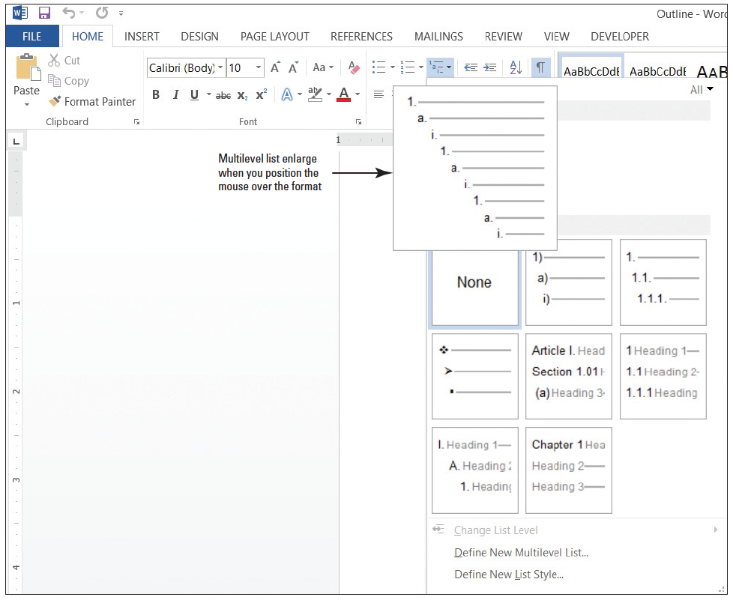
Step by Step: Create a Multilevel Outline List
Click the format style in the Current List section, as shown at right. The number 1. is inserted for you.
Type Experience, and then press the Enter key. When you press Enter, the number 2. is inserted.
Notes:
Take Note: Use the Tab key or Shift+Tab to move to different levels.

Slide 88
Step by Step: Create a Multilevel Outline List
Type Communication with Client and press the Enter key.
Press the Tab key and type Initial Meeting. Pressing the Tab key advances to the next level with a lowercase a. Press the Enter key.
Press the Tab key and type Identify Position. Notice that Word inserts a lowercase roman numeral as the next level. Press the Enter key.
Press the Tab key and type Qualifications. Another level is inserted beginning with the number 1. Press the Enter key.
Type Compensation Package and press the Enter key.
Type Time Frame and press the Enter key.

Slide 89
Step by Step: Create a Multilevel Outline List
Press Shift+Tab once to move back one level. Type Progress Reporting and press the Enter key.
Press Shift+Tab to move back one more level. Type Methods for Finding Candidates and press the Enter key.
Press the Tab key. Type Database and press the Enter key.
Type Contacts and press the Enter key.

Slide 90
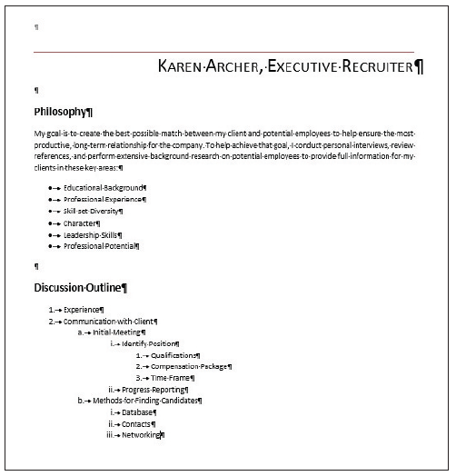
Step by Step: Create a Multilevel Outline List
Type Networking. Your document should resemble the one at right.
SAVE the document as Discussion Outline in the lesson folder on your flash drive.
PAUSE. LEAVE the document open for use in the next exercise.

Slide 91
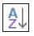
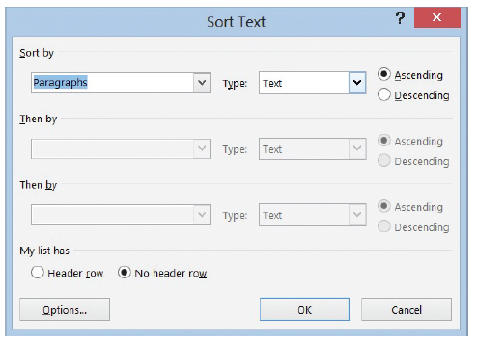
Step by Step: Sort a List’s Contents
USE the document that is open from the previous exercise.
Select the bulleted list under the Philosophy section.
On the Home tab, in the Paragraph group, click the Sort button. The Sort Text dialog box appears as shown below.

Slide 92
Step by Step: Sort a List’s Contents
Notice the Sort by field is listed by Paragraphs, the Type is listed by Text, and the Ascending order option is selected. Click OK.
The bulleted listed is sorted in alphabetical order.
SAVE the document as Discussion Outline Sorted in the lesson folder on your flash drive.
PAUSE. LEAVE the document open to use in the next exercise.

Slide 93
Modifying a Multilevel List
Word provides several options for changing the look of a list.
You can change a multilevel list by changing the list level, defining a new multilevel list, or defining a new list style. The same methods are used as when modifying bullets and numbering lists when increasing or decreasing the levels.
Some formats, such as round bullets, work well for most documents.

Slide 94
Step by Step: Modify the Multilevel List Level
USE the document that is open from the previous exercise.
Select the bulleted list.
On the Home tab, in the Paragraph group, click the drop-down arrow on the Bullets button. Previously in this lesson, you learned to change bullets—the same process is used here.
Click the square bullet format in the Bullet Library.
Select the multilevel list you typed previously.

Slide 95
Step by Step: Modify the Multilevel List Level
On the Home tab, in the Paragraph group, click the drop-down arrow on the Multilevel List button. A menu appears.
Under List Library, click the third column in the top row. Notice the difference in the numbering and alignment level.
SAVE the document as Discussion Outline Modified in the lesson folder on your flash drive, and then CLOSE the file.
PAUSE. LEAVE Word open for the next exercise.

Slide 96
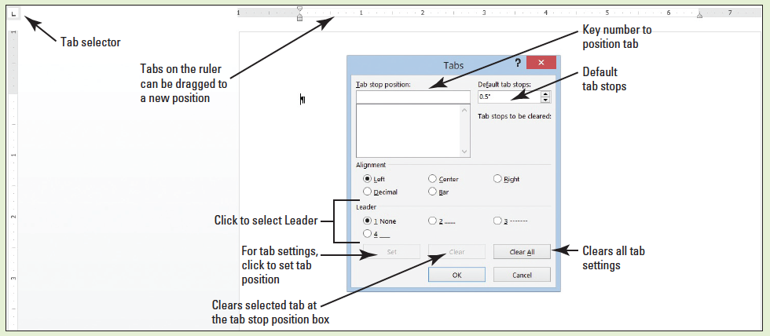
Software Orientation
Tabs in Word insert blank spaces before or within text and paragraphs. You use the Tabs dialog box, shown below, to set and clear tabs in Word.

Slide 97
Setting and Modifying Tabs
Tabs are used to align text or numbers in your document. The ruler can be used to set tabs or for more exact setting, use the Tabs dialog box.
As you set custom tabs to selected text, tabs are applied to paragraphs. When the Enter key is pressed, the tab settings are carried forward into the next paragraph.
Notes:
Take Note: To view Tabs as they are being set, display nonprinting characters, as discussed in Lesson 1.

Slide 98
Setting Tabs on the Ruler
By default, left-aligned tab stops are set every half-inch on the ruler.
To set a tab at a different position on the ruler, you can click the tab selector at the left end of the ruler and a ScreenTip will appear showing the type of tabs at the tab selector.
Tabs are part of a paragraph formatting—the selected text is affected by the tab setting or when modified.

Slide 99
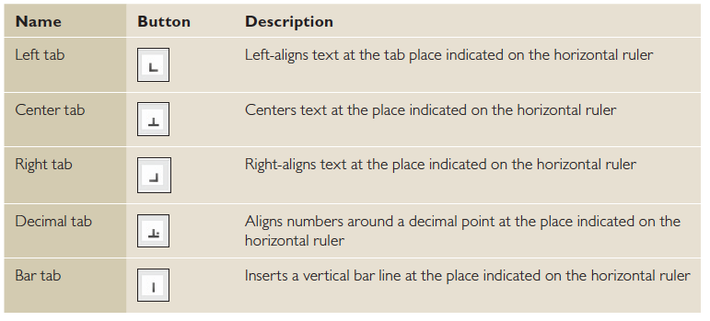
Setting Tabs on the Ruler
The table below lists the types of tabs available and their descriptions. To view tabs on the ruler, place your insertion point over the paragraph.
After tabs are set, press the Tab key; the insertion point moves to the position set. To move a tab stop to a different position on the ruler, click and drag the tab left or right to a new position.

Slide 100

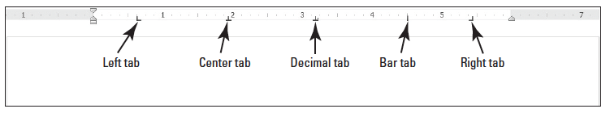
Step by Step: Set Tabs on the Ruler
OPEN Per Diem from the data files for this lesson.
On the Home tab in the Paragraph group, click the Show/Hide ( ¶ ) button to show nonprinting characters.
Place the insertion point on the blank line below the Meals & Incidentals Breakdown heading.
Click the tab selector at the left of the ruler until the Center tab appears. The tab selector and horizontal ruler are shown below, displaying the different types of tabs.
Notes:
Troubleshooting: If the horizontal ruler is not visible, click the View tab, and then add a check mark by Ruler.

Slide 101

Step by Step: Set Tabs on the Ruler
Click the ruler at the 2.5-inch mark to set a Center tab. The Center tab appears as an inverted T.
Click the ruler at the 4-inch mark to set a Center tab. The ruler shows two tabs settings.
Press Tab and type Chicago.
Press Tab and type New York.
Select the list of words starting with Breakfast and ending with Totals. When setting tabs, tabs are part of the paragraph formatting—the selected text will be affected by the tab settings after the Tab key is pressed.
Click the tab selector until the Right tab appears—displays as an inverted L.
Click the ruler at the 1-inch mark to set a Right tab.

Slide 102
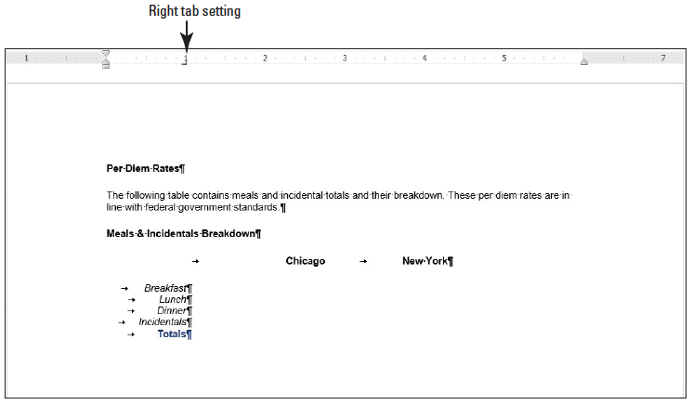
Step by Step: Set Tabs on the Ruler
Deselect the list, and place the insertion point in front of each word in the list, and then press Tab to align it at the Right tab. When setting a Right tab, press the Tab key with existing text or press the Tab key, and then type the new text. The text characters are aligned at the right and move to the left. Your document should look similar to the one shown below.
SAVE the document as Per Diem First Draft in the lesson folder on your flash drive.
PAUSE. LEAVE the document open to use in the next exercise.

Slide 103
Using the Tabs Dialog Box
The Tabs dialog box is useful for setting tabs at precise locations on the ruler, clearing all tabs, and setting tab leaders.
Tab leaders are symbols such as dotted, dashed, or solid lines that fill the space before a tab (see Figure 4-35).

Slide 104
Step by Step: Use the Tabs Dialog Box
USE the document that is open from the previous exercise.
Select the list of words starting with Breakfast and continuing to the end of the document.
On the Home tab, in the Paragraph group, click the dialog box laucher to launch the Paragraph dialog box.
Click the Tabs button on the bottom left of the Paragraph dialog box to display the Tabs dialog box. In the Tabs dialog box, you should see the 1" Right tab setting that you set in the previous exercise.
In the Tab stop position box, type 2.6. In the Alignment section, select Decimal. In the Leader section, select 2, and then click Set. After setting individuals tabs, you must click Set to position the tab setting.

Slide 105
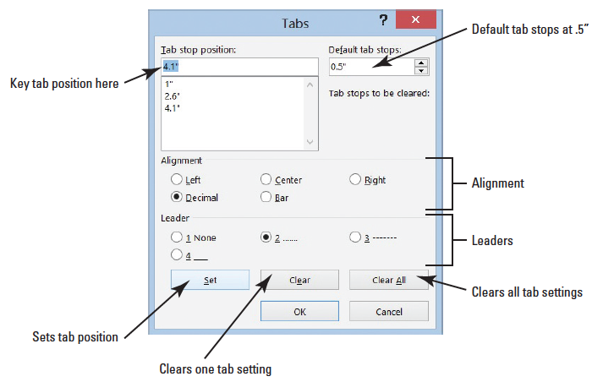
Step by Step: Use the Tabs Dialog Box
In the Tab stop position box, type 4.1. In the Alignment section, select Decimal. In the Leader section, select 2, and then click Set. Setting a leader provides a guide to the next tab setting. Refer to the figure below and compare with your screen.

Slide 106

Step by Step: Use the Tabs Dialog Box
Click OK to close the Tabs dialog box. Notice that nothing happens yet.
Place the insertion point after the word Breakfast and press Tab.
Type $10.98 and press Tab.
Type $12.50. Repeat this process for each line, typing the numbers shown above. Notice how the decimals align properly.
SAVE the document with the same filename in the lesson folder on your flash drive.
PAUSE. LEAVE the document open to use in the next exercise.
Notes:
Another Way: To open the Tabs dialog box, double-click any tab stop on the ruler. The Paragraph dialog box can also be accessed in the Page Layout tab. Also, you can right-click on selected text.

Slide 107
Step by Step: Move Tabs
USE the document that is open from the previous exercise.
Select the block of text beginning with Breakfast… and ending with …$63.49. Include the non-printing character (¶) in your selection.
Position the mouse pointer at 4.1" on the ruler until you see the Decimal Tab ScreenTip.
Press and hold the left mouse button and drag on the ruler to 5". Release the left mouse button. Notice the Decimal Tab setting for the five lines is positioned at 5" on the ruler.

Slide 108
Step by Step: Move Tabs
With the text still selected, position the mouse pointer at 2.6" on the ruler until you see the Decimal Tab ScreenTip.
Press and hold the left mouse button and drag on the ruler to 3". Release the left mouse button. Notice the Decimal Tab setting for the five lines is positioned at 3" on the ruler.
Select Chicago. Drag the center tab setting and position it at 3" on the ruler. Double-click the center tab on the ruler to open the Tabs dialog box—check the positioning of the tab. Chicago should align nicely above the amounts.

Slide 109
Step by Step: Move Tabs
Select New York. Drag the center tab setting and position it at 5" on the ruler. Double-click the center tab on the ruler to open the Tabs dialog box—check the positioning of the tab. New York should align nicely above the amounts.
SAVE the document as Per Diem Final in the lesson folder on your flash drive.
PAUSE. LEAVE the document open to use in the next exercise.

Slide 110
Clearing Tabs
Tabs can be removed by dragging them off the ruler, or you can use the Tabs dialog box to clear one or all tabs.
To remove a tab stop from the ruler, click and drag it off the ruler. When you release the mouse button, the tab stop disappears.
you can also clear one tab or all tabs in the Tabs dialog box.

Slide 111
Step by Step: Clear Tabs
USE the document that is open from the previous exercise.
Place the insertion point on the last line (Totals).
Move your mouse pointer to the tab stop at 5" on the ruler. Wait for the ScreenTip to appear.
Press and hold the mouse button and drag it off the ruler. Release the mouse button to remove the tab stop. The amount moves to the left.
On the Home tab, in the Paragraph group, click the dialog box launcher to launch the Paragraph dialog box.
Click the Tabs button on the bottom left of the dialog box to display the Tabs dialog box.

Slide 112
Step by Step: Clear Tabs
In the Tab stop position list, click 3", and then click Clear to clear that tab.
Click the Clear All button to clear all tabs on that line.
Click OK to close the Tabs dialog box.
Select all the text on the Totals line and press the Delete button to delete it.
SAVE the document with the same filename, and then CLOSE the file.
PAUSE. LEAVE Word open for the next exercise.

Slide 113
Setting Tab Stops
Tab stops can be reset from the default of 0.5 inch. Each time you press the tab key, the tab moves half an inch on the ruler.
Thus, by pressing the tab key twice, for example, the insertion point moves to one inch on the ruler.

Slide 114
Step by Step: Set Tab Stops
OPEN a new blank document.
Press the Tab key once.
Press the Tab key two more times; the insertion point is now positioned at 1½ inches on the ruler.
Press the Tab key three times; the insertion point moves to the 3-inch mark on the ruler. Each time you press the Tab key, it advances half an inch on the ruler. By default, the tab stops are set at half an inch.
Press Enter.
Notes:
Another Way: Press Ctrl+N to use the shortcut key to open a new, blank document.

Slide 115
Step by Step: Set Tab Stops
On the Home tab, in the Paragraph group, click the dialog box launcher.
In the Paragraph dialog box, click the Tabs button to open the Tabs dialog box.
Click the up arrow below Default Tab Stops until it stops at 1 inch. Click OK.
Press the Tab key three times and notice the insertion point on the ruler now stops at every 1 inch.
STOP. CLOSE Word without saving the changes.
Notes:
Take Note: Many of the predesigned document layout options in Word 2013 make it possible to create documents, such as an index or table of contents, without setting any tabs manually.

Slide 116
Skills Summary

